Slide 1
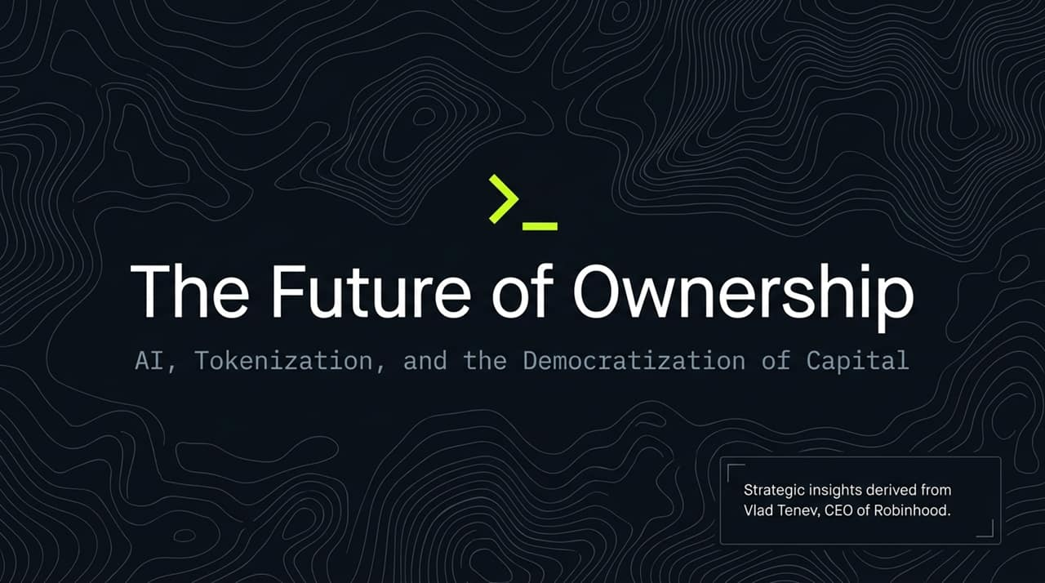
Notes:
Good morning, everyone. Welcome to today’s session on 'The Future of Ownership: AI, Tokenization, and the Democratization of Capital.'
Today, we are taking a deep dive into the strategic vision articulated by Vlad Tenev, CEO of Robinhood, in his recent interview on The Iced Coffee Hour. Over the past year alone, Robinhood's Assets Under Custody grew by over 50%, reaching a massive $125 billion.
But this presentation isn't just about Robinhood's growth numbers—it's about a fundamental transformation in global finance. We will explore three central pillars driving this transformation:
Artificial Intelligence: How AI is moving from simple advisory algorithms to full agentic, autonomous execution in trading and software engineering.
Asset Democratization: How private venture capital and global equities are being unlocked for retail investors.
Tokenization: How blockchain and stablecoin rails will enable a borderless, 24/7 global financial ecosystem.
By the end of this deck, you will see how these strategic vectors align to move society toward a default ownership model.
https://www.youtube.com/watch?v=KJ_dtGyqNP8

Slide 2
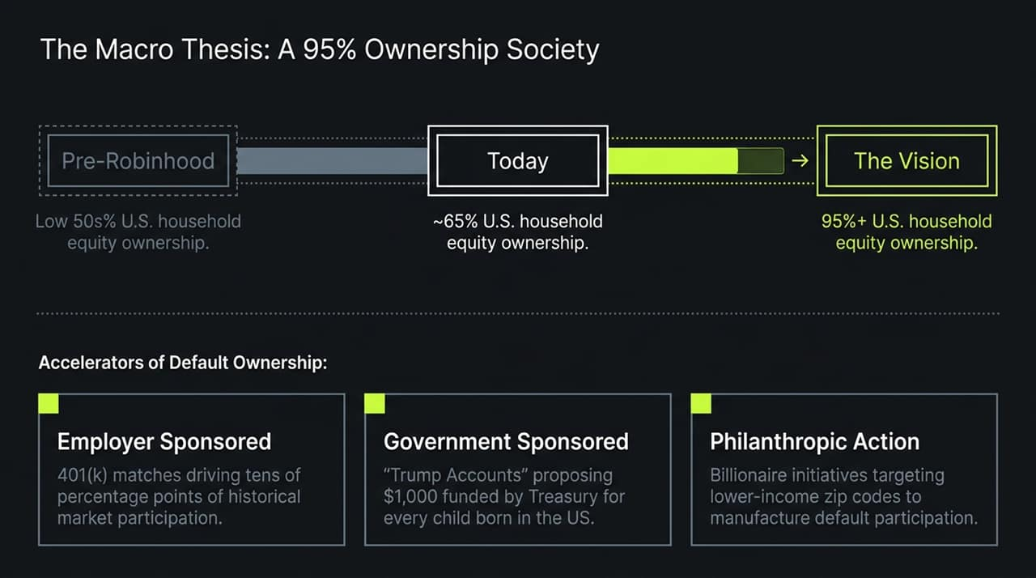
Notes:
Let’s start with the central overarching thesis: A 95%+ Equity Ownership Society.
As Vlad Tenev pointed out, a future with relatively few asset owners is inherently fragile and socially unstable. In the pre-Robinhood era, U.S. household equity participation sat in the low 50s percentile. Over the past decade, driven heavily by zero-commission trading and mobile accessibility, that participation rate has risen to approximately 65%.
However, the ultimate target is to push equity ownership to over 95% of households. How do we bridge that gap when millions of people are living paycheck to paycheck and lack surplus capital to invest?
The answer lies in Accelerators of Default Ownership:
Employer-Sponsored Programs: Historically, employer 401(k) matches drove tens of percentage points in participation by making market entry 'automatic' and incentivized.
Government-Sponsored Initiatives: Proposals like the 'Trump Accounts' aim to allocate $1,000 from the Treasury to every child born in the U.S. at birth, establishing compounding wealth from age zero.
Philanthropic Action: High-net-worth individuals and philanthropists (like Michael Dell and Ray Dalio) are funding accounts targeting lower-income ZIP codes to manufacture market participation.
By creating mechanisms that default people into ownership at birth or employment, market equity becomes universal rather than an exclusive club.

Slide 3
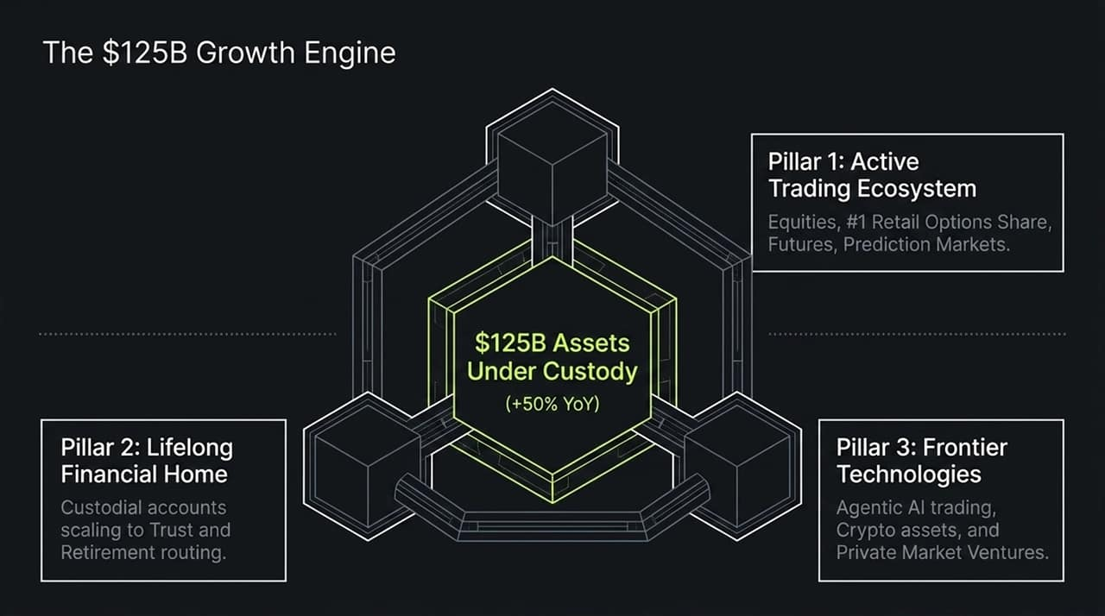
Notes:
To understand how this vision scales commercially, we examine the core growth engine that has driven Robinhood's $125 billion in Assets Under Custody—a 50% year-over-year surge.
This engine operates across Three Strategic Pillars:
Pillar 1: Active Trading Ecosystem: Robinhood maintains the #1 market share in retail options trading, backed by expansion into equities, futures, and rapid growth in prediction markets.
Pillar 2: Lifelong Financial Home: Moving away from transactional relationships, Robinhood captures user assets through 3% match retirement accounts, custodial accounts, and trust routing.
Pillar 3: Frontier Technologies: Integrating agentic AI trading, crypto assets, and private market venture funds directly into the user interface.
By linking high-velocity trading with long-term custodial wealth management, the platform creates an end-to-end moat that retains user assets through every life stage.

Slide 4
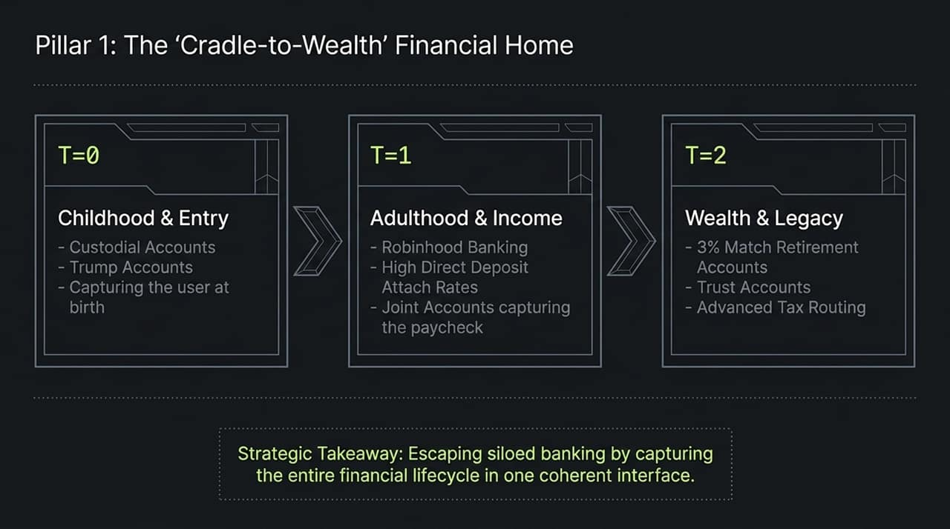
Notes:
Let's unpack Pillar 1: The 'Cradle-to-Wealth' Lifecycle Model.
Traditional legacy banking relies on siloed products—a consumer might have a savings account with one bank, an IRA with another, and a mortgage elsewhere. The goal here is to capture the user's entire financial lifecycle within one unified UI:
T = 0 (Childhood & Entry): Capturing users at birth through custodial accounts and government-backed options like Trump Accounts.
T = 1 (Adulthood & Income): Transitioning young adults into primary banking through Robinhood Banking, joint accounts, and high direct deposit attach rates.
T = 2 (Wealth & Legacy): Retaining mature wealth through retirement accounts (boosted by 3% matches), advanced tax-loss harvesting routing, and trust accounts.
Strategic takeaway: Escaping the transactional trap of standalone brokerages by capturing wealth from birth through estate inheritance.

Slide 5
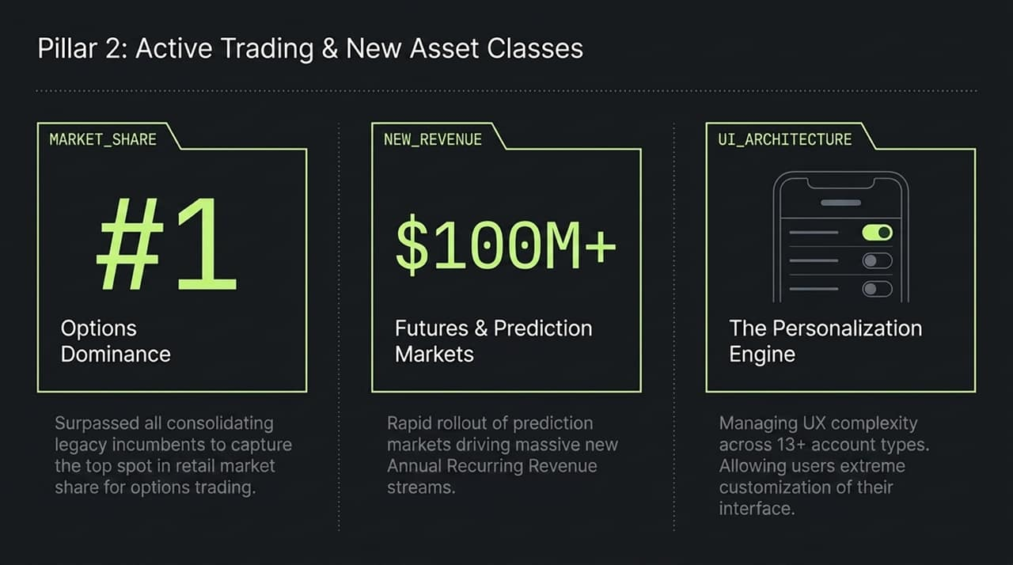
Notes:
Turning to Pillar 2, we look at how trading innovation continues to generate strong top-line revenue:
#1 Retail Options Market Share: Robinhood outpaced legacy incumbents to secure the top market position in options trading volume.
$100M+ ARR in Futures & Prediction Markets: The rapid rollout of prediction markets allows retail users to hedge and speculate on real-world events, creating a major new annual recurring revenue stream.
UI Personalization Engine: Supporting over 13 distinct account types without overwhelming the user interface requires an ultra-customizable UI architecture where users toggle complex features on or off as needed.

Slide 6
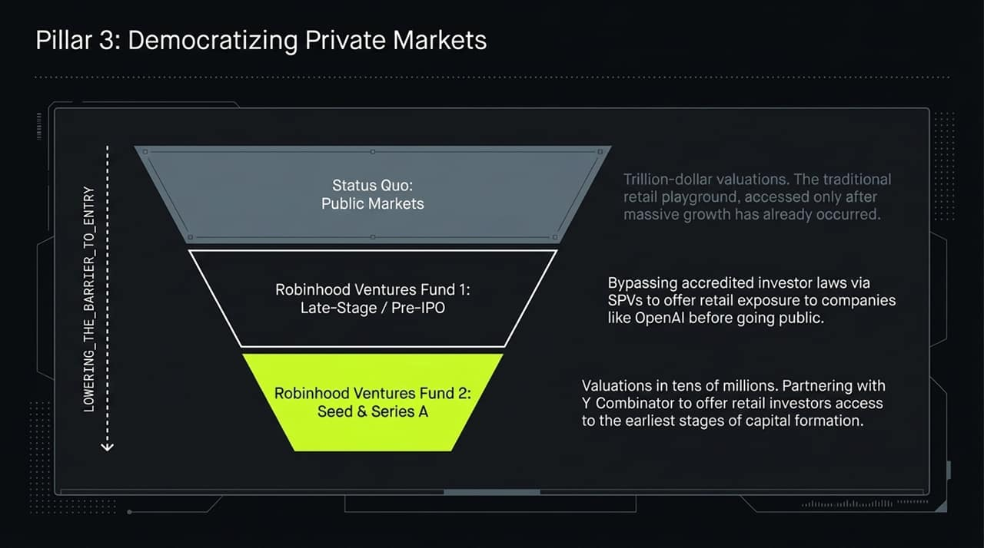
Notes:
Historically, the biggest wealth accumulation happens in private markets before a company goes public. By the time a tech giant hits public markets at a trillion-dollar valuation, retail investors miss out on the early growth multiplier.
Pillar 3 addresses this imbalance by opening private market investments to retail users:
Robinhood Ventures Fund 1 (Late-Stage / Pre-IPO): Uses Special Purpose Vehicles (SPVs) to bypass traditional accredited investor barriers, granting retail investors exposure to late-stage private powerhouses like OpenAI.
Robinhood Ventures Fund 2 (Seed & Series A): Partnering with seed accelerators like Y Combinator to allow retail capital access to companies valued in the tens of millions.
This shifts retail investing from passive public trading to early-stage capital formation.

Slide 7
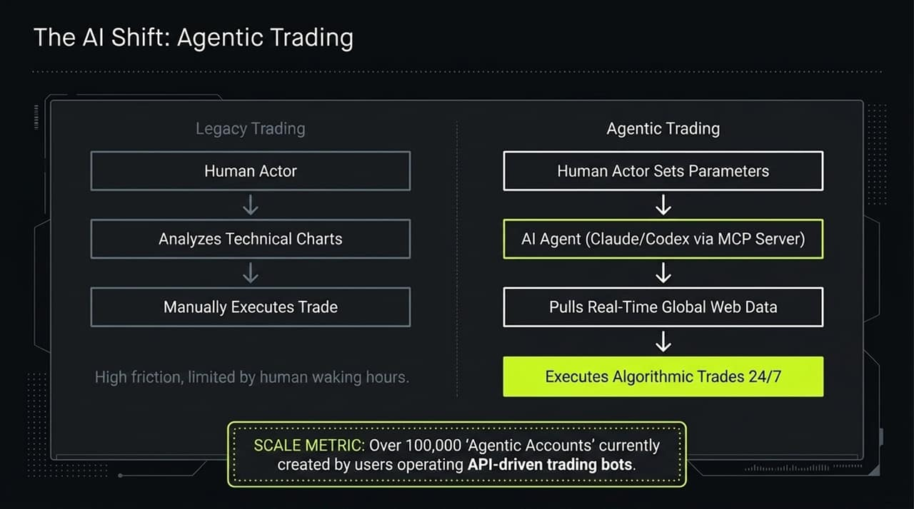
Notes:
Now let's discuss the fundamental shift taking place in AI: Agentic Trading.
In the Legacy Trading framework, a human trader looks at technical charts during waking hours, manually entering orders with significant friction and time constraints.
In the Agentic Trading model, the human simply sets macro parameters or rules. An AI agent (e.g., Claude or Codex operating via Model Context Protocol servers) continuously monitors global data feeds, analyzes market signals, and executes trades autonomously 24/7.
Scale Metric: Over 100,000 'Agentic Accounts' have already been created on Robinhood by users operating API-driven trading bots, signaling a major paradigm shift toward autonomous finance.

Slide 8
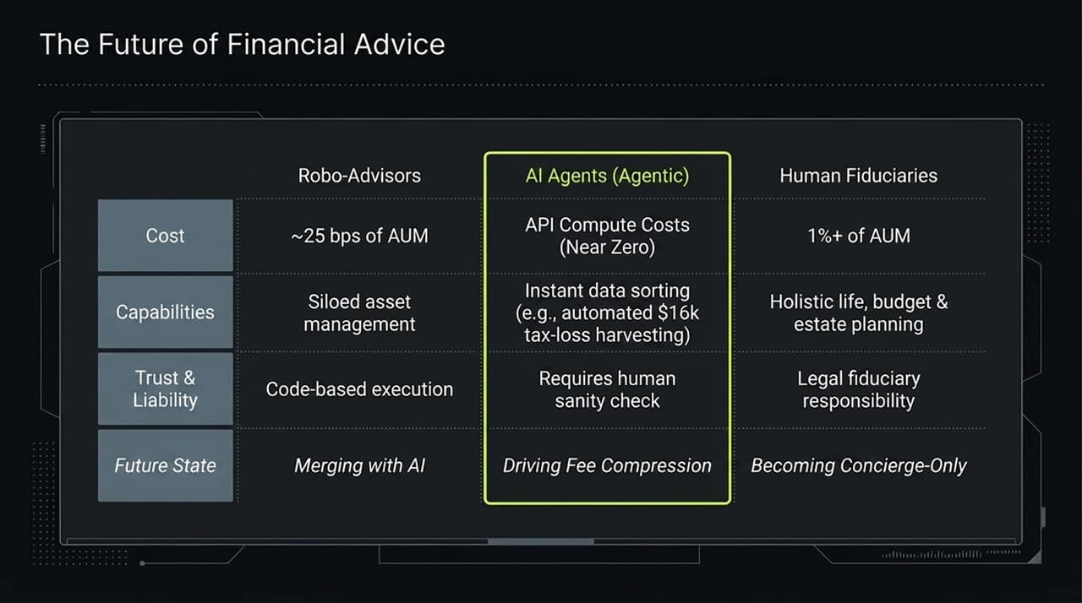
Notes:
How does this shift affect wealth management and financial advisors?
This slide compares Robo-Advisors, AI Agents, and Human Fiduciaries:
Robo-Advisors: Charge ~25 bps of AUM for basic, rule-based portfolio management. They are increasingly merging into AI frameworks.
Human Fiduciaries: Charge 1%+ of AUM. While necessary for complex legal or estate needs, their high fees will push them into ultra-wealthy 'concierge-only' roles.
AI Agents: Operating at near-zero compute costs, AI agents perform real-time, complex data tasks—such as executing an automated $16,000 tax-loss harvest in seconds.
As AI tools mature, they will compress advisory fees across the industry while elevating automated execution for retail accounts.

Slide 9
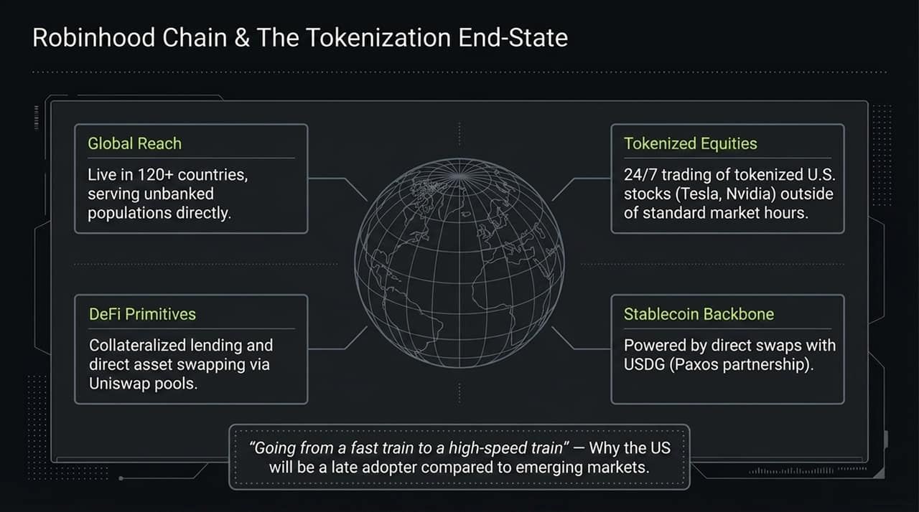
Notes:
Next, we look at the infrastructure layer enabling global, borderless finance: Robinhood Chain and Tokenization.
While U.S. adoption may feel like moving 'from a fast train to a high-speed train,' emerging markets will adopt tokenization rapidly due to underdeveloped banking infrastructure:
Global Reach: Live in over 120 countries, bringing financial services directly to unbanked populations.
Tokenized Equities: Enabling 24/7 fractional trading of top U.S. stocks (like Tesla and Nvidia) outside standard market hours.
Stablecoin Backbone: Powered by direct USDG swaps through Paxos partnerships.
DeFi Primitives: Integrating collateralized lending and direct asset swaps via Uniswap liquidity pools.

Slide 10
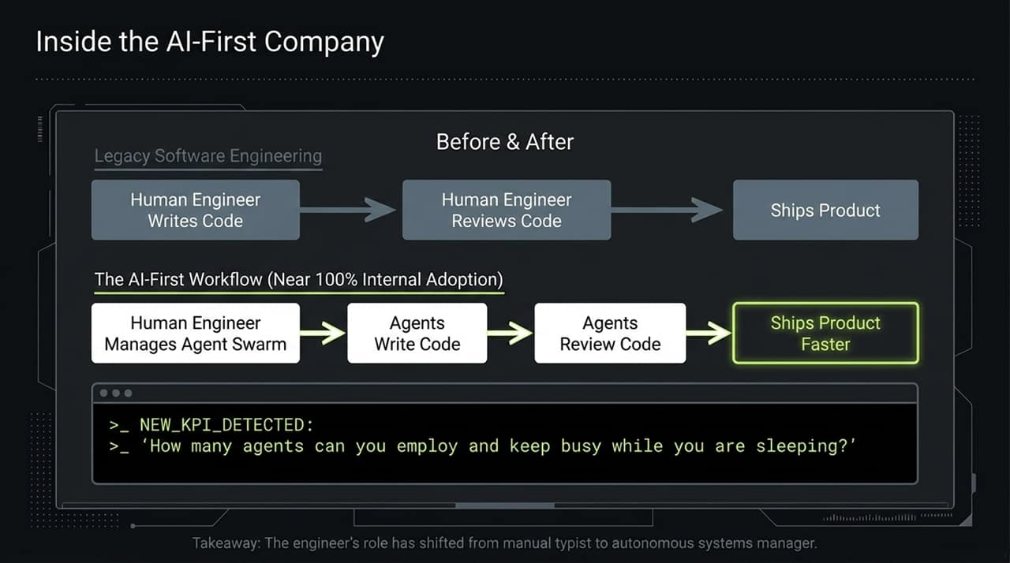
Notes:
AI isn't just changing customer products; it's completely transforming internal software engineering.
Legacy Software Engineering: Human writes code -> Human reviews code -> Product ships.
AI-First Engineering: Human acts as a systems manager over a swarm of AI agents. AI agents write the code, AI agents review the code, and products ship significantly faster.
At Robinhood, internal adoption of AI-assisted engineering is near 100%. The key leadership metric for modern engineering leads has become: 'How many agents can you employ and keep busy while you are sleeping?'

Slide 11
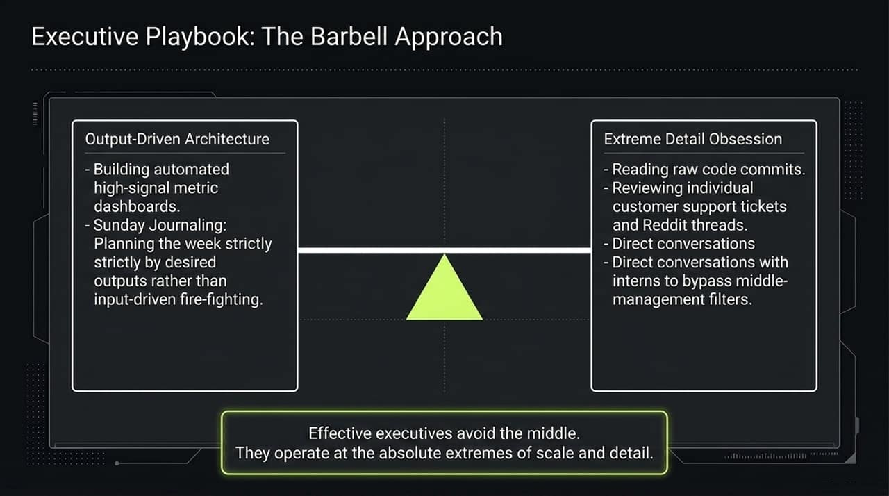
Notes:
How do executives manage an organization at this velocity? Vlad Tenev uses The Barbell Management Approach.
Effective leaders avoid middle-management layers and operate at the absolute extremes of scale and detail:
Extreme Scale (Output-Driven Architecture): Weekly Sunday journaling focused purely on required business outputs rather than reactive fire-fighting. High-signal automated dashboards track core performance metrics.
Extreme Detail (Granular Inspection): Directly reading raw code commits, reviewing support tickets, reading community feedback on Reddit, and speaking with interns to bypass reporting filters.

Slide 12
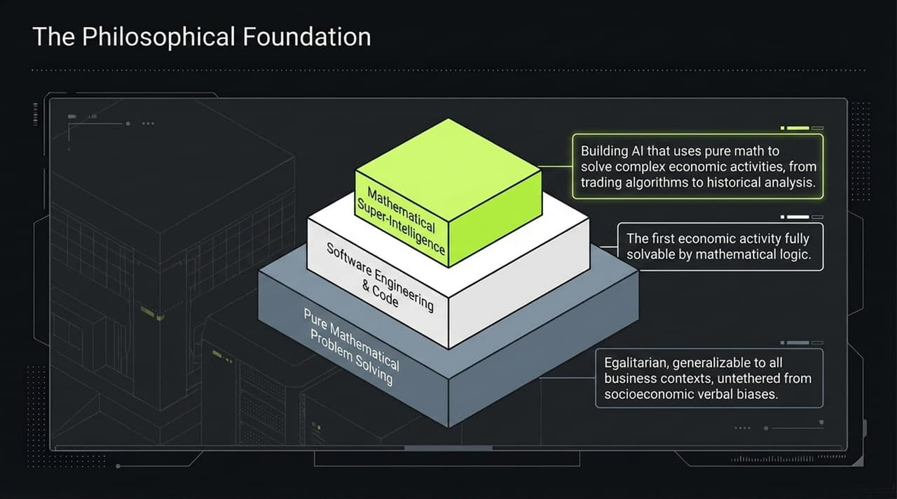
Notes:
Underpinning this entire framework is a philosophical view on AI development: Mathematical Super-Intelligence.
Financial markets are the first major economic activity that can be fully solved through pure mathematical logic.
Language models can introduce socioeconomic or verbal biases. By grounding AI models in pure mathematical problem-solving, algorithms remain egalitarian, objective, and generalizable across all global market conditions.

Slide 13
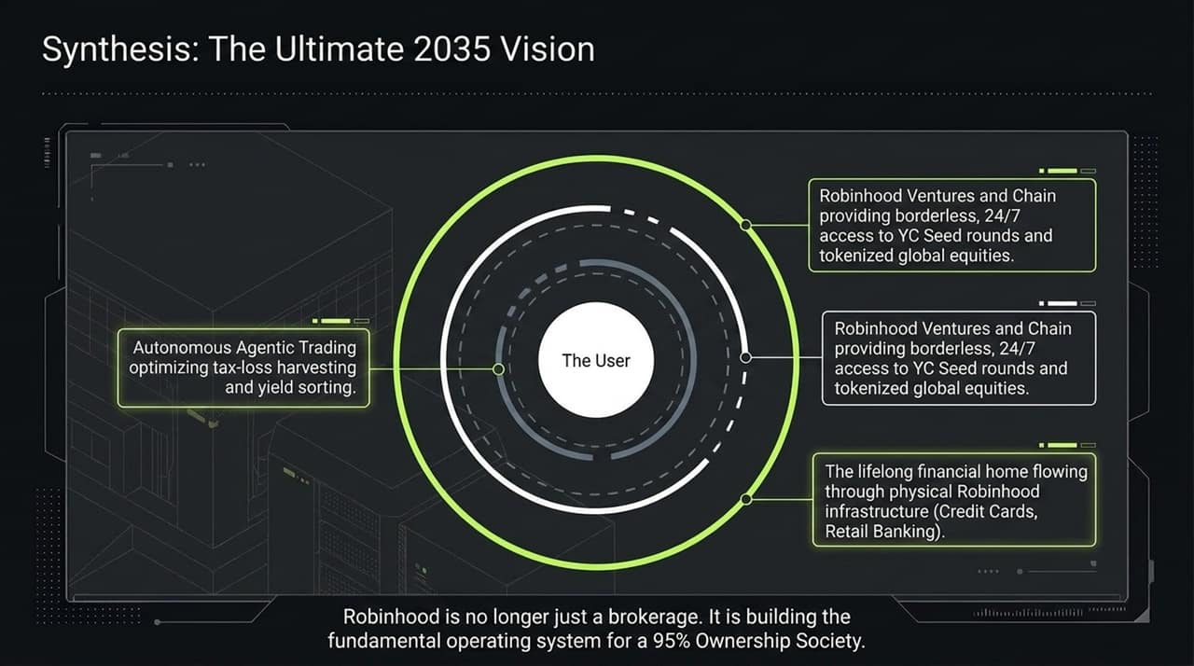
Notes:
Bringing all these threads together, we see the vision for 2035.
Robinhood is evolving beyond a retail brokerage into an all-encompassing financial operating system:
The User sits at the center, supported by Autonomous Agentic Trading that manages yield and tax optimization in real time.
Private Markets & Blockchain Rails offer 24/7 global access to seed-stage investments and tokenized real-world assets.
Integrated Physical Infrastructure—including retail banking and credit cards—creates a complete lifecycle platform.

Slide 14
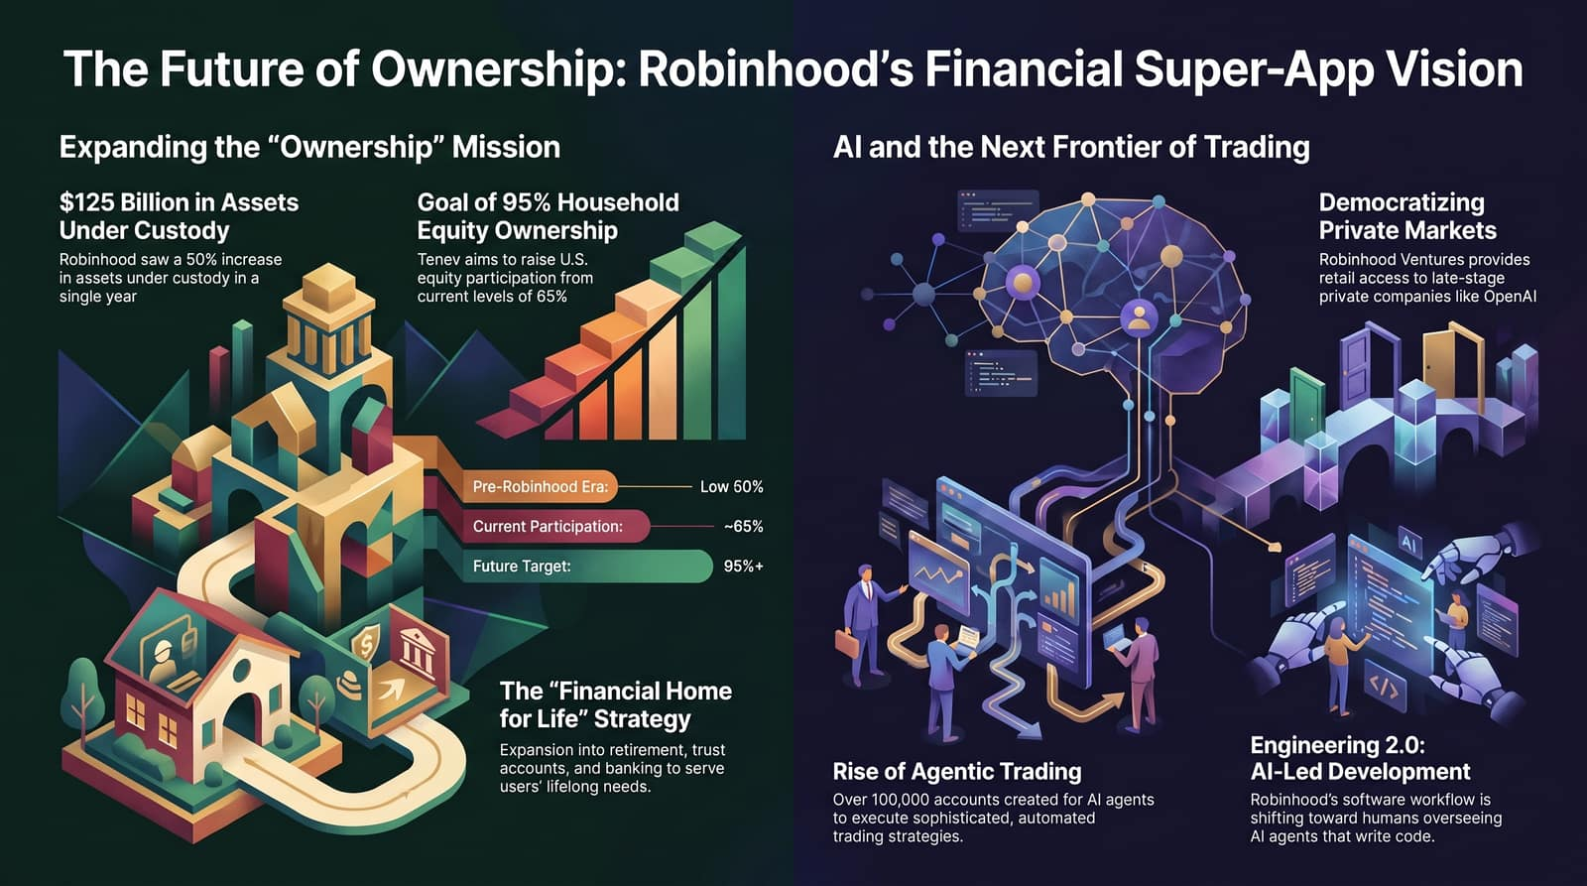
Notes:
To wrap up our discussion today, let's review the four overarching takeaways from the presentation:
Democratization Goal: Expanding household equity participation from 65% toward the 95%+ target.
Lifelong Engagement: Capturing asset flows across every stage of life—from custodial childhood accounts to retirement and trust planning.
Agentic Execution: Leveraging over 100,000 AI agent trading accounts and adopting AI-first engineering internally.
Global Tokenization: Building 24/7 tokenized market infrastructure on Robinhood Chain to power a borderless ownership economy.
Thank you for your time, and I am happy to open the floor to any questions!

